Slide 1

Natural Language Processing DLO 8012
Subject In-charge
Ms Vincy Joseph
Assistant Professor
email: vincyjoseph@sfit.ac.in

Slide 2
Module V
Lecture 28 Discourse Integration

Slide 3
Discourse Model
The discourse model contains representations of the entities that have been referred to in the discourse and the relationships in which they participate.
There are 2 fundamental operations to discourse model.
When a referent is first mentioned in a discourse, we say that a representation for it is evoked into the model.
Upon subsequent mention, this representation is accessed from the model.

Slide 4
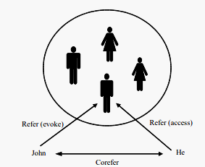
Discourse Model
Example:
John went to Bill’s car dealership to check out an Acura Integra. He looked at it for about an hour.

Slide 5
Reference Phenomena
There are several referential phenomena in natural languages.
Five among them explored here are:
Indefinite noun phrases, definite noun phrases, pronouns, demonstratives and one-anaphora.
Three types of referents complicate the reference resolution problem:
Inferrables, discontinuous sets, and generics.

Slide 6
Indefinite Noun Phrases
Indefinite reference introduces entities that are new to the hearer into the discourse context.
Common form of indefinite reference is marked with the determiner a (or an),by a quantifier (some) or even determiner this.
I saw a Mercedes Benz today.
Some Mercedes Benz were being unloaded at the local dealership today.
I saw this awesome Mercedes Benz today.

Slide 7
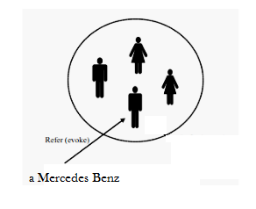
Indefinite Noun Phrases
Such noun phrases evoke a representation for a new entity.

Slide 8
Definite Noun Phrases
Deﬁnite reference is used to refer to an entity that is
identiﬁable to the hearer
it is contained in the hearer’s set of beliefs about the world
the uniqueness of the object is implied by the description itself.
E.g.
I saw an Acura Integra today. The Integra was white and needed to be washed.
The Indianapolis 500 is the most popular one in US.
The fastest car in the Indianapolis 500 was an Integra.

Slide 9
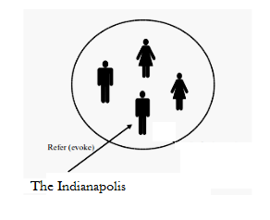
Definite Noun Phrases
A Definite Noun Phrase also evokes a representation of the referent into the discourse model.

Slide 10
Pronouns
Pronominalization is another form of deﬁnite reference
E.g. I saw an Acura Integra today. It was white and needed to be washed.
The constraints on using pronouns is that it should refer to entities that were introduced no further than one or two sentences back in the ongoing discourse, whereas deﬁnite noun phrases can often refer further back.

Slide 11
Example
a. John went to Bob’s party, and parked next to a beautiful Acura Integra.
b. He went inside and talked to Bob for more than an hour.
c. Bob told him that he recently got engaged.
d. He also said that he bought it yesterday.
d’. He also said that he bought the Acura yesterday.
By the time the last sentence is reached, the Integra no longer has the degree of salience required to allow for pronominal reference to it

Slide 12
Pronouns as Cataphora
Pronouns are mentioned before their referents are called Cataphoras
E.g. Before he bought it, John checked over the Integra very carefully.
Here, the pronouns he and it both occur before their referents are introduced.

Slide 13
Demonstratives
Demonstrative pronouns, like this and that, can appear either alone or as determiners (this Acura, that Acura).
The choice between two demonstratives is based on spatial proximity:
this indicating closeness and
that signaling distance.
Spatial distance might be measured with respect to the discourse participants situational context.

Slide 14
Demonstratives
E.g. I bought an Integra yesterday. It’s similar to the one I bought ﬁve years ago. That one was really nice, but I like this one even better.
Here, that one refers to the Acura bought ﬁve years ago (greater temporal distance), whereas this one refers to the one bought yesterday (closer temporal distance).

Slide 15
One Anaphora
One-anaphora, blends properties of deﬁnite and indeﬁnite reference.
E.g.
She has a white car. I also want one
She has the best BMW. I also want one like that.
This usage is paraphrased by one of them, in which ‘them’ refers to a plural referent & one is a member from this set.
Thus, one may evoke a new entity which is dependent on an existing referent.

Slide 16
One Anaphora
This use of one should be distinguished from the formal, non-speciﬁc pronoun usage and its meaning as the number one as shown below.
E.g.
One shouldn’t pay more than twenty thousand dollars for an Acura.
John has two Acuras, but I only have one.

Slide 17
End

